Slide 1
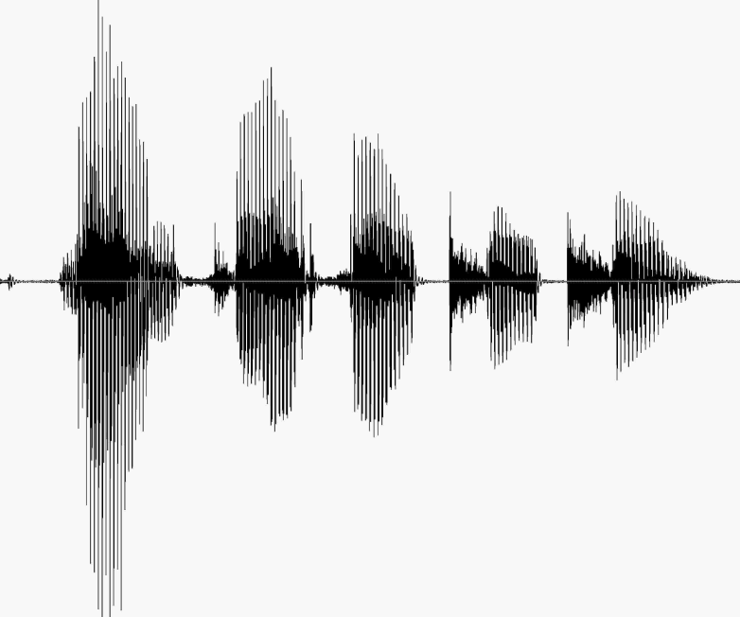
CS 224S / LINGUIST 285 Spoken Language Processing
Andrew Maas
Stanford University
Spring 2017
Lecture 7: Neural network acoustic models in speech recognition

Slide 2
Outline
Hybrid acoustic modeling overview
Basic idea
History
Recent results
What’s different about modern DNNs?
Convolutional networks
Recurrent networks
Alternative loss functions

Slide 3
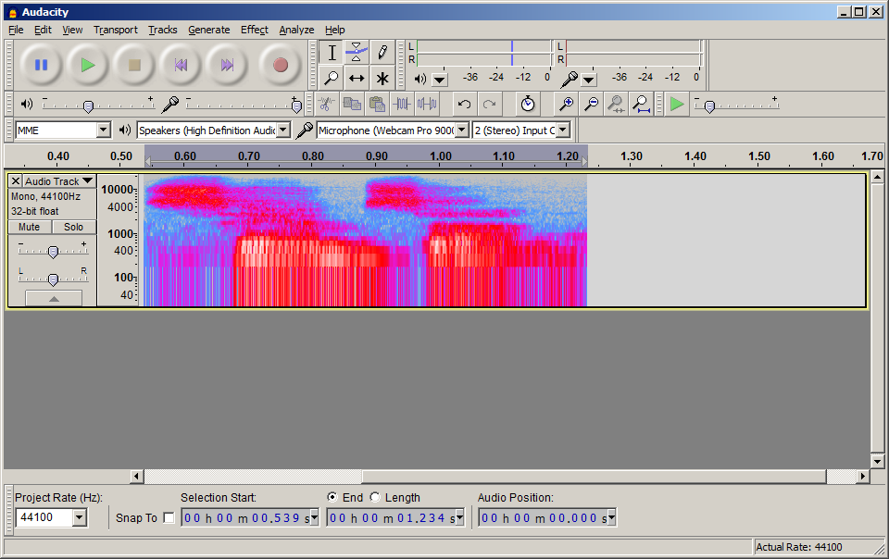
Acoustic Modeling with GMMs
Transcription:
Pronunciation:
Sub-phones :
Hidden Markov Model (HMM):
Acoustic Model:
Audio Input:
Samson
S – AE – M – S –AH – N
942 – 6 – 37 – 8006 – 4422 …
942
942
6
GMM models:
P(x|s)
x: input features
s: HMM state
Features
Features
Features
Notes:
This is a generative model, meaning we need to understand all of how an HMM state ‘creates’ input features x

Slide 4
DNN Hybrid Acoustic Models
Transcription:
Pronunciation:
Sub-phones :
Hidden Markov Model (HMM):
Acoustic Model:
Audio Input:
Samson
S – AE – M – S –AH – N
942 – 6 – 37 – 8006 – 4422 …
942
942
6
P(s|x₁)
P(s|x₂)
P(s|x₃)
Use a DNN to approximate:
P(s|x)
Apply Bayes’ Rule:
P(x|s) = P(s|x) * P(x) / P(s)
DNN * Constant / State prior
Features (x₁)
Features (x₂)
Features (x₃)

Slide 5
Noisy Channel Model
Probabilistic implication: Pick the highest prob S:
We can use Bayes rule to rewrite this:
Since denominator is the same for each candidate sentence W, we can ignore it for the argmax:

Slide 6
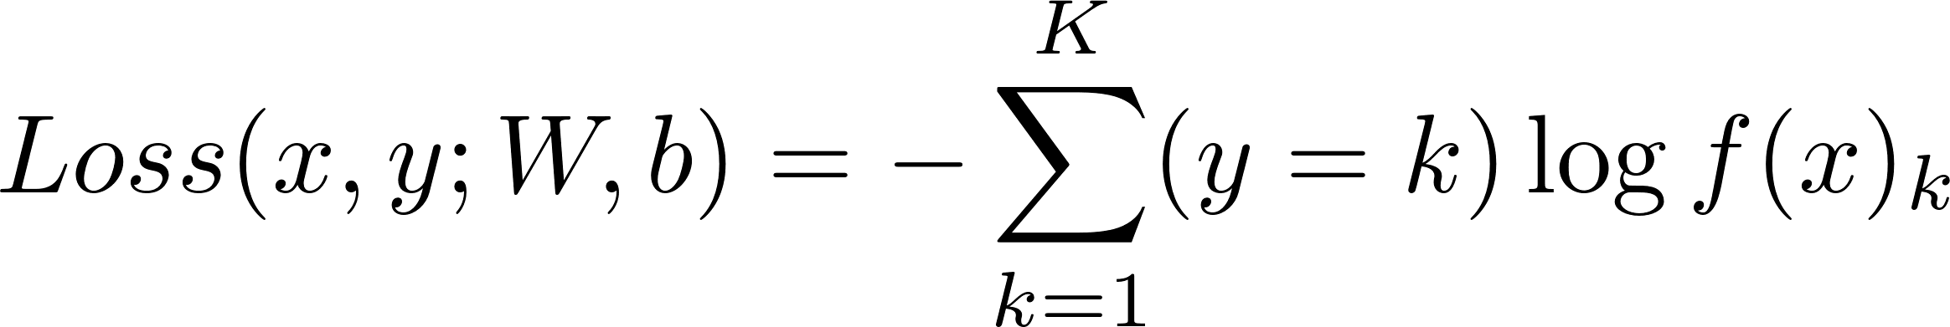
Objective Function for Learning
Supervised learning, minimize our classification errors
Standard choice: Cross entropy loss function
Straightforward extension of logistic loss for binary
This is a frame-wise loss. We use a label for each frame from a forced alignment
Other loss functions possible. Can get deeper integration with the HMM or word error rate

Slide 7
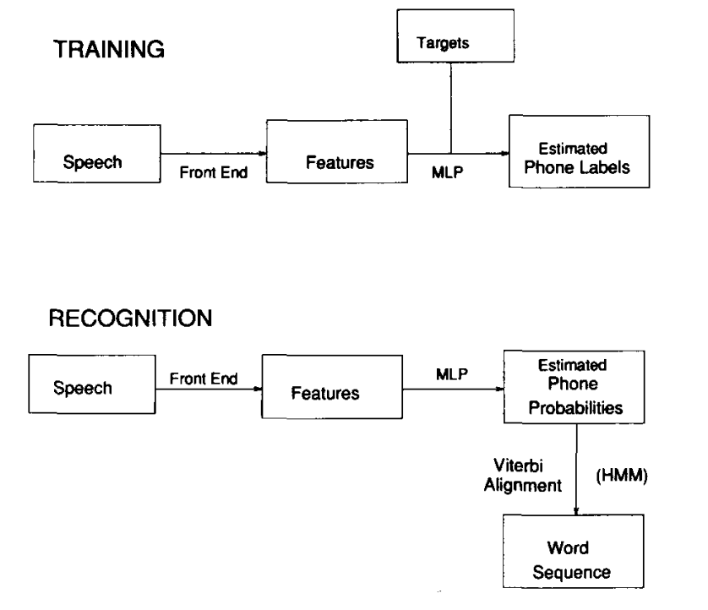
Not Really a New Idea
Renals, Morgan, Bourland, Cohen, & Franco. 1994.

Slide 8
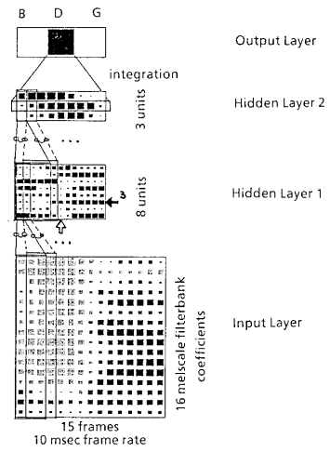
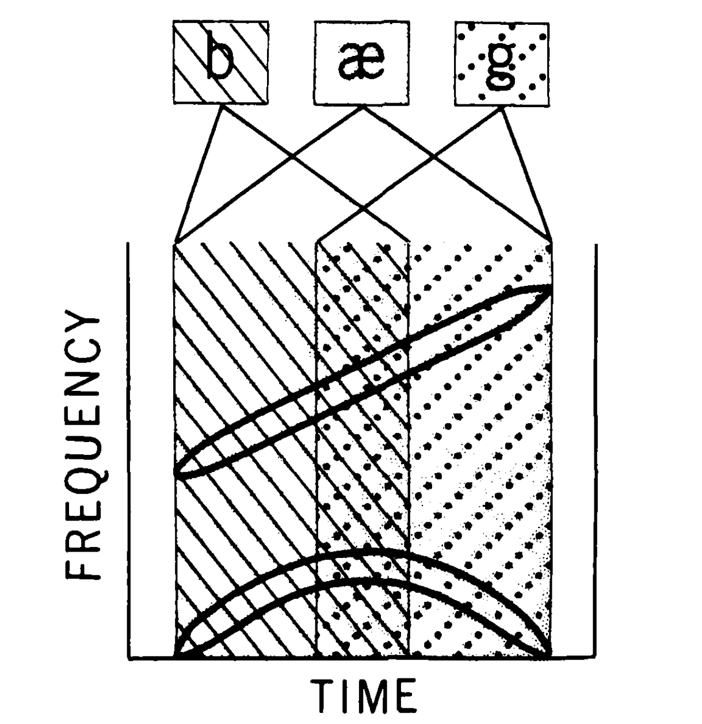
Early neural network approaches
(McClelland, & Elman. 1985)
(Waibel, Hanazawa, Hinton, Shikano, & Lang. 1988)
Notes:
http://www.sciencedirect.com/science/article/pii/0010028586900150

Slide 9
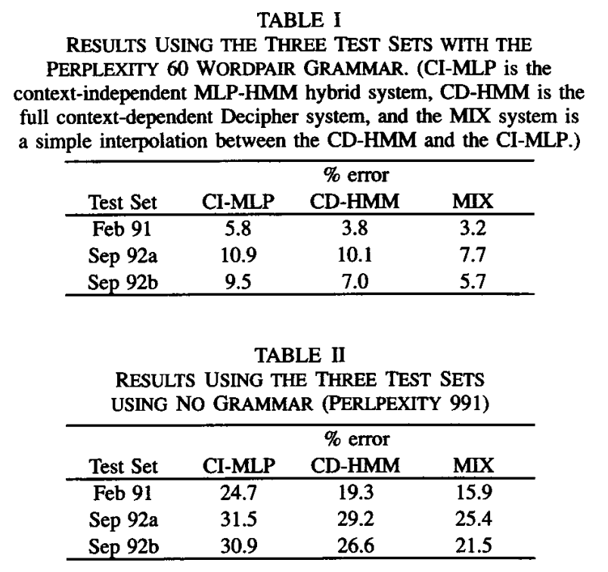
Hybrid MLPs on Resource Management
Renals, Morgan, Bourland, Cohen, & Franco. 1994.

Slide 10
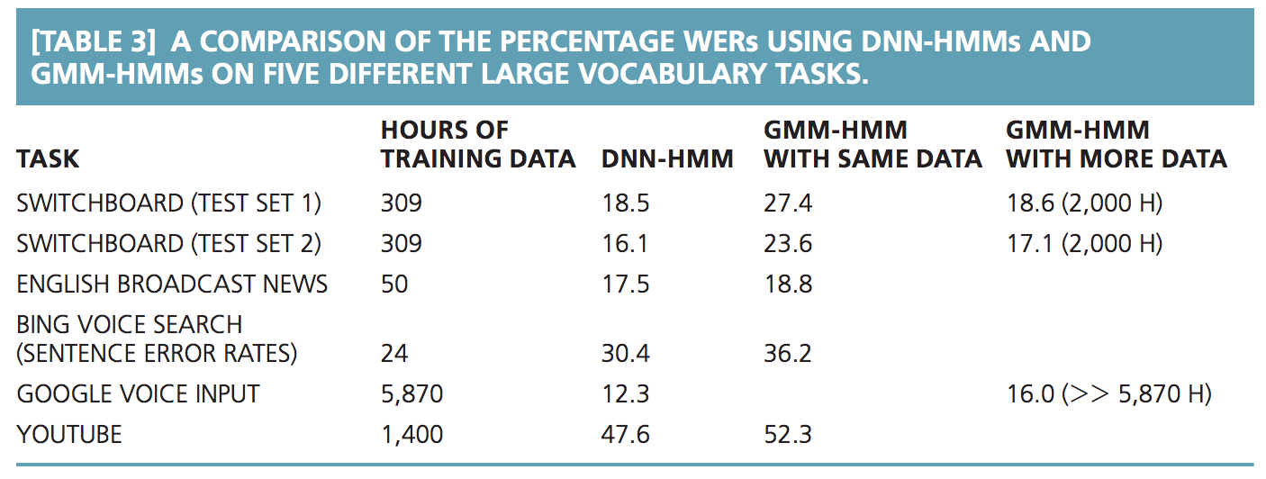
Hybrid Systems now Dominate ASR
Hinton et al. 2012.

Slide 11
What’s Different in Modern DNNs?
Context-dependent HMM states
Deeper nets improve on single hidden layer nets
Hidden unit nonlinearity
Many more model parameters (scaling up)
Specific depth (e.g. 3 vs 7 hidden layers)
Fast computers = run many experiments
Architecture choices (easiest is replacing sigmoid)
Pre-training does not matter. Initially we thought this was the new trick that made things work

Slide 12
Modern Systems use DNNs and Senones
(Dahl, Yu, Deng, & Acero. 2011)
(Yu, Seltzer, Li, Huang, & Seide. 2013)

Slide 13
Many hidden layers
Warning! Depth can also act as a regularizer because it makes optimization more difficult. This is why you will sometimes see very deep networks perform well on TIMIT or other small tasks.

Slide 14
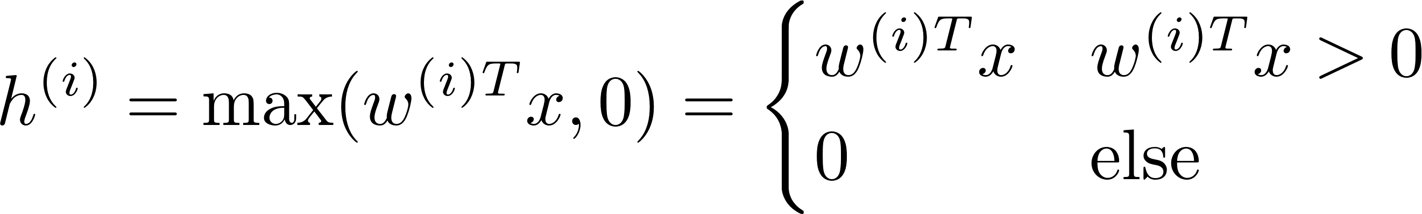
Replacing Sigmoid Hidden Units
Rectified Linear (ReL)
(Glorot & Bengio. 2011)
Notes:
So we waited 15 years, computers got faster and datasets got larger. Is that all there is to DNNs?
No, it turns out that success of DNNs also relies on advances to optimization techniques and in some cases network architecture choices.
We found that rectifiers were critical to easily producing a nearly SOTA hybrid system

Slide 15
Comparing Nonlinearities
(Maas, Qi, Xie, Hannun, Lengerich, Jurafsky, & Ng. 2017)
Notes:
Baseline GMM triphone system contains 3,034 senones. Speaker-level CMVN and fMLLR adaptation are applied to MFCC features . For DNNs, we use a context of +/- 3 frames and apply LDA to reduce features to 300 dimensions
Each DNN hidden layer has 2048 hidden units. A 3 layer DNN thus has ~15.2 million parameters
Relatively simple optimization setup. SGD with momentum without preconditioning or other tricks. No pretraining

Slide 16
Rectifier DNNs on Switchboard
Model | Dev Acc(%) | Switchboard WER
GMM Baseline | N/A | 25.1
2 Layer Tanh | 48.0 | 21.0
2 Layer ReLU | 51.7 | 19.1
3 Layer Tanh | 49.8 | 20.0
3 Layer RelU | 53.3 | 18.1
4 Layer Tanh | 49.8 | 19.5
4 Layer RelU | 53.9 | 17.3
9 Layer Sigmoid CE [MSR] | -- | 17.0
7 Layer Sigmoid MMI [IBM] | -- | 13.7
Maas, Hannun, & Ng,. 2013.
Notes:
Baseline GMM triphone system contains 3,034 senones. Speaker-level CMVN and fMLLR adaptation are applied to MFCC features . For DNNs, we use a context of +/- 3 frames and apply LDA to reduce features to 300 dimensions
Report frame-level cross entropy (CrossEnt) and class accuracy (Acc) on a separate development set
Evaluate word error rate (WER) using DNN senone likelihoods in a hybrid recognizer. The Eval2000 test set contains the switchboard and callhome subsets
Each DNN hidden layer has 2048 hidden units. A 3 layer DNN thus has ~15.2 million parameters
Relatively simple optimization setup. SGD with momentum without preconditioning or other tricks. No pretraining

Slide 17
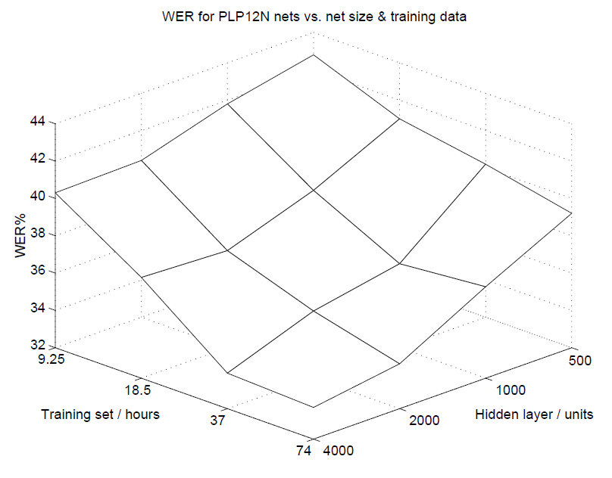
Scaling up NN acoustic models in 1999
0.7M total NN parameters
[Ellis & Morgan. 1999]
Notes:
Context for 0.7M params.
Modern LVCSR hybrid systems use ~36M params
I’ll present results for 200M params and we are currently training models with 400M params

Slide 18
Adding More Parameters 15 Years Ago
Size matters: An empirical study of neural network training for LVCSR. Ellis & Morgan. ICASSP. 1999.
Hybrid NN. 1 hidden layer. 54 HMM states.
74hr broadcast news task
“…improvements are almost always obtained by increasing either or both of the amount of training data or the number of network parameters … We are now planning to train an 8000 hidden unit net on 150 hours of data … this training will require over three weeks of computation.”

Slide 19
Adding More Parameters Now
(Maas, Qi, Xie, Hannun, Lengerich, Jurafsky, & Ng. 2017)
Notes:
Comparing total number of parameters (in millions) of previous work versus our new experiments

Slide 20
Scaling Total Parameters on Switchboard
(Maas, Qi, Xie, Hannun, Lengerich, Jurafsky, & Ng. 2017)

Slide 21
Scaling Total Parameters on Switchboard
(Maas, Qi, Xie, Hannun, Lengerich, Jurafsky, & Ng. 2017)

Slide 22
Experimental Framework
1-4 GPUs using the infrastructure of Coates et al (ICML 2013)
Improved baseline GMM system. ~9,000 HMM states
Fix DNN hidden layers to 5
Vary total number of parameters, same number of hidden units in each hidden layer
Evaluate input context of 21 and 41 frames
Sizes evaluated: 36M, 100M, 200M
Layer sizes: 2048, 3953, 5984
Output layer: 51% of all parameters for a 36M DNN 6% of all parameters for a 200M DNN

Slide 23
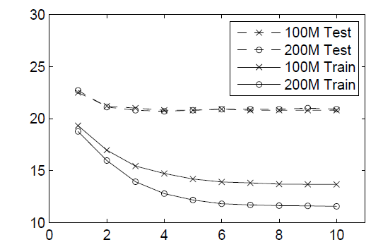
Word error rate during training
Training Epochs

Slide 24
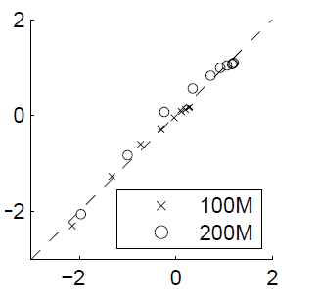
Correlating frame-level metrics and WER
Training Epochs
Normalize training set word accuracy and negative cross entropy separately. Strong correlation (r=0.992) suggests that cross entropy is a good predictor of training set WER
Notes:
Our correlation analysis and the training curves suggest that cross entropy may be a suitable loss function, and that we can think of this as a classic machine learning challenge of improving generalization

Slide 25
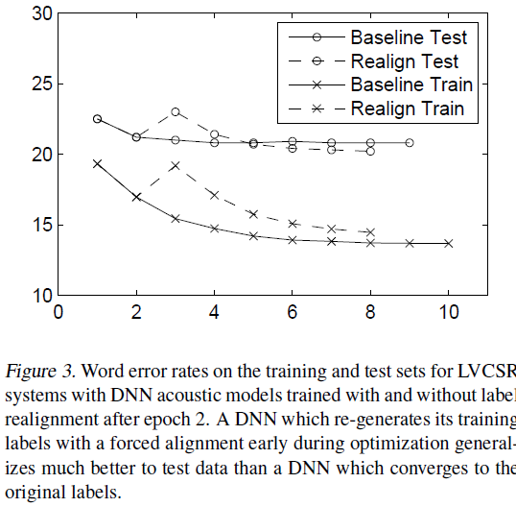
Generalization: Early realignment
Notes:
Aside: our initial plan was to do continuous asynchronous realignment but it turns out that changing the labels significantly during training can lead to divergence or worse results. It did seem better to realign earlier in training if you plan to continue optimizing the same DNN

Slide 26
Generalization: Dropout
During training randomly zero out hidden unit activations with probability p=0.5
Cross validate over p in initial experiments
Previous work found dropout helped on 50hr broadcast news but did not directly evaluate dropout with control experiments (Dahl et al 2013, Sainath et al 2013)

Slide 27
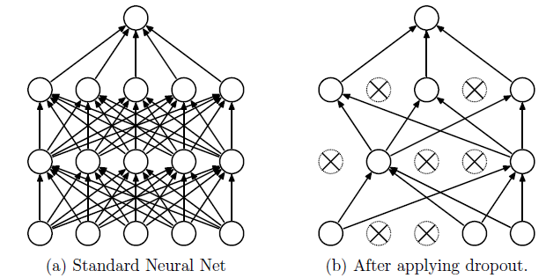
Improving Generalization with Dropout
(Srivastava, Hinton, Kirzhevsky, Sutskever, & Salakhutdinov. 2014)

Slide 28
Improving Generalization with Dropout
(Maas, Qi, Xie, Hannun, Lengerich, Jurafsky, & Ng. 2017)

Slide 29
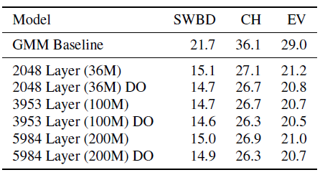
Improving Generalization with Dropout

Slide 30
Combining Speech Corpora
Switchboard
Fisher
300 hours
2,000 hours
4,870 speakers
23,394 speakers
Combined corpus baseline system now available in Kaldi
(Maas, Qi, Xie, Hannun, Lengerich, Jurafsky, & Ng. In Submission)

Slide 31
Scaling Total Parameters Revisited
(Maas, Qi, Xie, Hannun, Lengerich, Jurafsky, & Ng. 2017)

Slide 32
Scaling Total Parameters Revisited
(Maas, Qi, Xie, Hannun, Lengerich, Jurafsky, & Ng. 2017)

Slide 33
Impact of Depth
(Maas, Qi, Xie, Hannun, Lengerich, Jurafsky, & Ng. 2017)

Slide 34
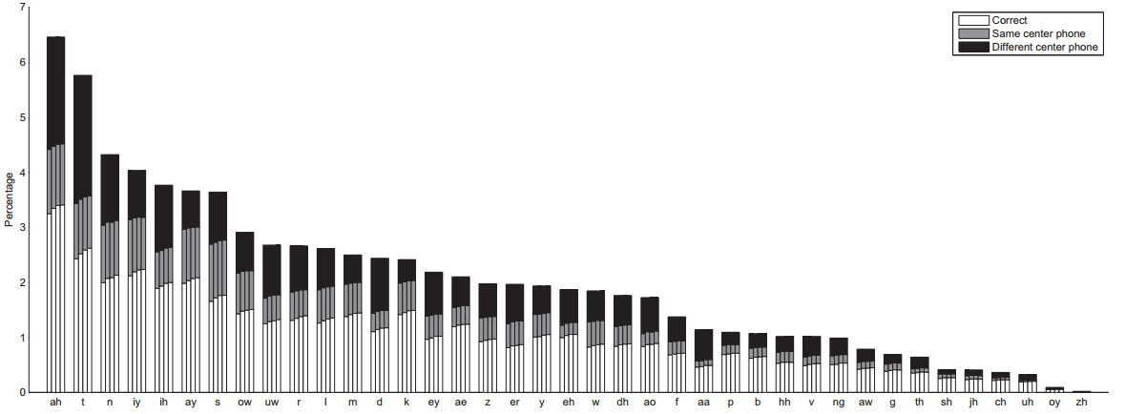
Frame accuracy analysis
(Maas, Qi, Xie, Hannun, Lengerich, Jurafsky, & Ng. 2017)

Slide 35
Building A Strong DNN Acoustic Model
Large
At least 3 hidden layers
Training data
Less important:
Dropout regularization
Specific optimization algorithm settings
Initialization (we don’t need pre-training)
(Maas, Qi, Xie, Hannun, Lengerich, Jurafsky, & Ng. 2017)

Slide 36
Outline
Hybrid acoustic modeling overview
Basic idea
History
Recent results
What’s different about modern DNNs?
Convolutional networks
Recurrent networks
Alternative loss functions

Slide 37
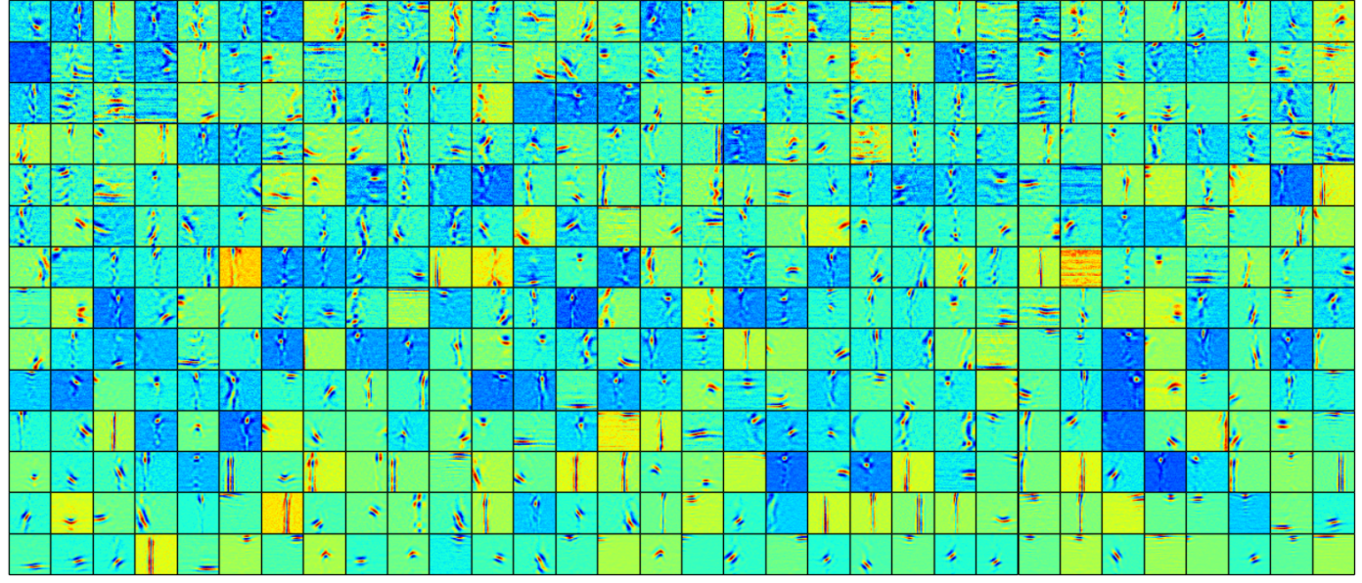
Visualizing first layer DNN features

Slide 38
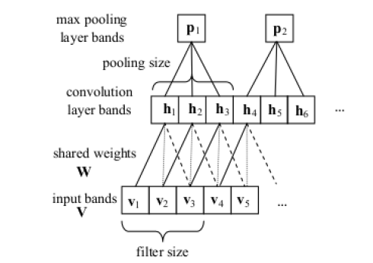
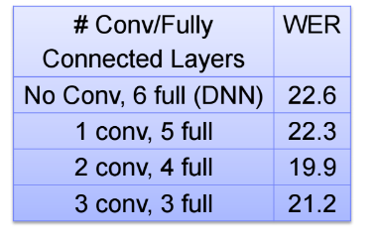
Convolutional Networks
Slide your filters along the frequency axis of filterbank features
Great for spectral distortions (e.g. short wave radio)
(Sainath, Mohamed, Kingsbury, & Ramabhadran. 2013)
Notes:
50hr broadcast news task

Slide 39
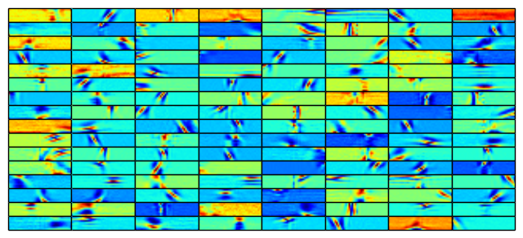
Learned Convolutional Features

Slide 40
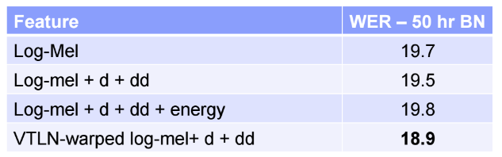
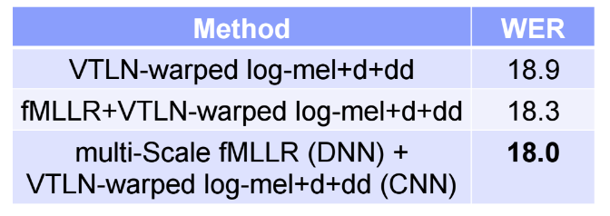
Features for convolutional nets
Porting VTLN and fMLLR feature transforms important
Slide from Tara Sainath

Slide 41
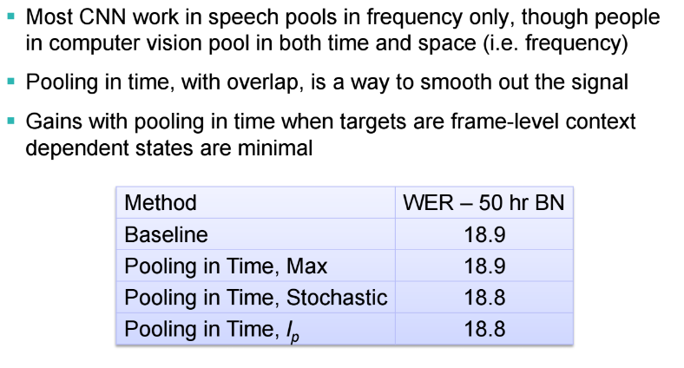
Pooling in time
Slide from Tara Sainath

Slide 42
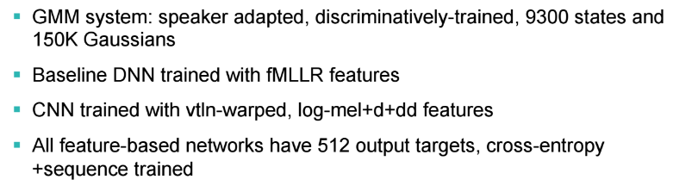
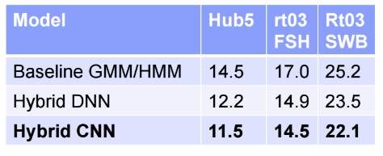
Comparing CNNs, DNNs, & GMMs
Slide from Tara Sainath

Slide 43
Recurrent DNN Hybrid Acoustic Models
Transcription:
Pronunciation:
Sub-phones :
Hidden Markov Model (HMM):
Acoustic Model:
Audio Input:
Samson
S – AE – M – S –AH – N
942 – 6 – 37 – 8006 – 4422 …
942
942
6
P(s|x₁)
P(s|x₂)
P(s|x₃)
Features (x₁)
Features (x₂)
Features (x₃)

Slide 44
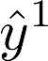
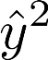
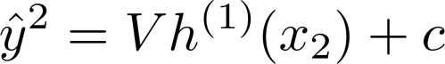
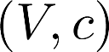
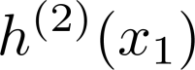
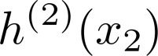
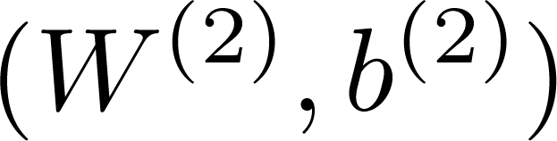

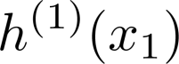
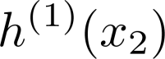
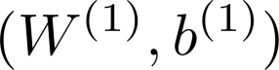
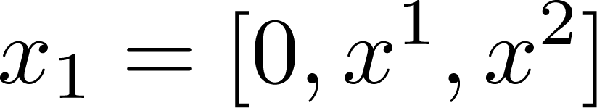
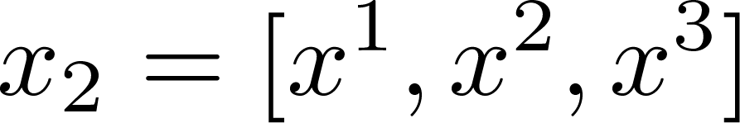

Deep Recurrent Network
Output Layer
Hidden Layer
Hidden Layer
Input

Slide 45
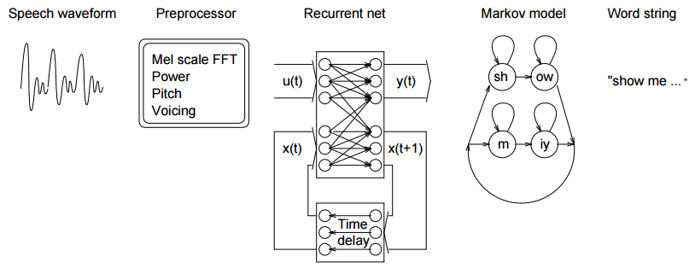
RNNs for acoustic modeling in 1996
(Robinson, Hochberg, & Renals. 1996)

Slide 46
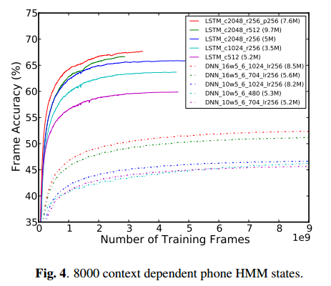
LSTM RNN on Google voice search
Best LSTM WER: 10.5%
Best DNN WER: 11.3%
LSTM required half the training time
(Sak, Senior, & Beufays. 2014)

Slide 47
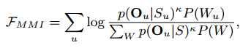
Alternative loss functions
Scalable minimum Bayes risk (sMBR)
Minimum phone error (MPE)
Maximum mutual information (MMI)
Move beyond frame classification to decoder outputs

Slide 48
Other Current Work
Multi-lingual acoustic modeling
Low resource acoustic modeling
Learning directly from waveforms without complicated feature transforms

